Slide 1


DESIGN AND DEVELOPMENT OF PUF FOR HARDWARE SECURITY UPDATE
DEPARTMENT OF ELECTRONICS ENGINEERING
MIT CAMPUS, ANNA UNIVERSITY
BATCH : 2022-2026
Guided by:
Dr. V. R. Vijaykumar,
Professor,
Department of Electronics Engineering,
Madras Institute of Technology,
Anna University.
Presented by:
Navabharathi T (2022504526)
Dharshan R (2022504517)
Lakshmanan S (2022504310)

Slide 2
MOTIVATION
Modern hardware devices like smart cards, IoT devices, and medical instruments are increasingly targeted by reverse engineering, cloning, and side-channel attacks, posing serious threats to device identity and digital trust.
In 2023, a global investigation revealed over 1 billion counterfeit electronic components infiltrating critical sectors such as military, automotive, and healthcare. These fake chips endangered national security, as they could be maliciously modified or fail during operation.
Though there are traditional hardware security methods, like fuses or non-volatile memory (NVM) for key storage, they are vulnerable to physical attacks. Once the memory is read or duplicated, the entire system is compromised.
Physically Unclonable Functions (PUFs) offer a novel, low-power, and tamper-evident solution by leveraging random manufacturing variations in silicon. This enables unique, unclonable hardware IDs, removing the need to store sensitive keys—making it ideal for lightweight, embedded security systems.

Slide 3
OBJECTIVE
To develop a robust Arbiter PUF using Verilog HDL.
To analyze the uniqueness of the Arbiter PUF by generating responses to multiple challenges and comparing the responses across different PUF instances.
To evaluate various PUF metrices such as Inter-chip variation, Intra-chip variation, uniformity, reliability and bit-aliasing.
To implement the developed Arbiter PUF in FPGA platform, focusing on validating its functionality.

Slide 4
INTRODUCTION
A Physically Unclonable Function (PUF) is a hardware-specific security primitive designed to provide cryptographic functionalities such as secure key generation and device authentication, especially for embedded and IoT systems.
The physical structure of a PUF is simple to manufacture but extremely difficult or impossible to replicate, due to uncontrollable variations in the semiconductor fabrication process.While many systems use binary classification (real vs. fake), this approach can be limiting.
A PUF generates a unique output, known as a response, to a given input challenge, based on the intrinsic physical differences present in each Integrated Circuit (IC). These responses are used as digital fingerprints for secure and tamper-resistant identification

Slide 5
LITERATURE SURVEY
S. NO | AUTHOR | TITLE | JOURNAL DETAILS WITH YEAR | SIGNIFICANT CONTRIBUTION
1 | Yao Wang, Guangyang Zhang, Xue Mei, and Chongyan Gu | A High-Reliability, Non-CRP-Discard Arbiter PUF Based on Delay Difference Quantization | IEEE Transactions on Circuits and Systems—I: Regular Papers, Vol. 72, No. 2,, pp. 573–585 February 2025 | Inference : Proposed a delay-difference-based Arbiter PUF (DDQ-APUF) with 99.95% reliability, no CRP discarding, and enhanced ML attack resistance using pseudo-XOR. Problem Identified : Conventional Arbiter PUFs show poor reliability on FPGAs and require CRP filtering or error correction, increasing overhead and security risk.
2 | Bjoern Driemeyer, Holger Mandry, David-Peter Wiens, Joachim Becker, John G. Kauffman, Maurits Ortmanns | An Eye-Opening Arbiter PUF for Fingerprint Generation Using Auto-Error Detection for PVT-Robust Masking and Bit Stabilization Achieving a BER of 2e-8 in 28nm CMOS | IEEE International Solid-State Circuits Conference (ISSCC), Session 17.5 2025, | Inference : Proposed an eye-opening Arbiter PUF combining RO and arbiter benefits with on-chip auto-error detection and masking, achieving ultra-low BER (2e–8) without off-chip data. Problem Identified : PUFs struggle to maintain stability under process, voltage, and temperature (PVT) variations without high overhead or off-chip helper data.

Slide 6
LITERATURE SURVEY
S. NO | AUTHOR | TITLE | JOURNAL DETAILS WITH YEAR | SIGNIFICANT CONTRIBUTION
3 | Sivappriya Manivannan, Rajat Subhra Chakraborty, Indrajit Chakrabarti, and Jothi Ramalingam | “Practical and Efficient PUF-Based Protocol for Authentication and Key Agreement in IoT” | IEEE Embedded Systems Letters, vol. 16, no. 2, pp. 118–121, 2024 | Inference: Proposed a lightweight authentication and key agreement protocol using Arbiter PUF, Fuzzy Extractor, and ECDH. Problem Identified: Conventional systems store large CRP sets or require pairing operations—both unsuitable for IoT.
4 | S. Hemavathy and V. S. Kanchana Bhaaskaran | “Arbiter PUF—A Review of Design, Composition, and Security Aspects ” | IEEE Access, vol. 11, pp. 33979–33993, 2023 | Inference: Provided a comprehensive review of Arbiter PUF designs, metrics, and their resilience against ML attacks. Many existing PUF architectures are still susceptible to deep learning and side-channel modeling.

Slide 7
TYPES OF PUF
PUF maps the input challenge with a unique response, thus creating a challenge-response pair (CRP).
WEAK PUF:
Limited number of Challenge-Response pairs.
Used for cryptographic key generation.
STRONG PUF:
Large number of CRPs.
Used for authentication without using external cryptographic hardware.

Slide 8
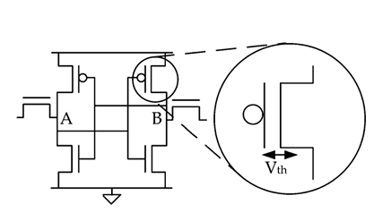
WEAK PUF
SRAM PUF (Memory based PUF)
Power-on state of SRAM cells generates unique Challenge-Response pair.
Other weak PUFs include Butterfly PUF, Ring-Oscillator PUF, etc.

Slide 9
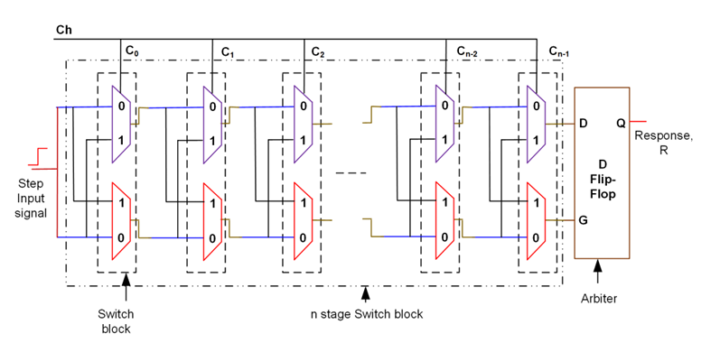
STRONG PUF
Arbiter PUF (Delay based PUF)
Uses manufacturing variability in gate delay as the source of unclonable randomness i.e. a race condition is established in a symmetric circuit.
Other strong PUFs include Optical PUF, Feed-Forward Arbiter PUF, etc.

Slide 10
BLOCK DIAGRAM
Input Challenge (n-bit)
Challenge Register
Switch Network (Controlled by Challenge)
Delay Line Stages
PUF Response
(1-bit)
Arbiter (Timing Comparator)
Signal Race Paths

Slide 11
FUTURE SCOPE
Enhance Security: Improve the Arbiter PUF architecture using XOR or hybrid models to increase resistance against machine learning and side-channel attacks.
FPGA Implementation: Deploy the design on FPGA platforms for real-time testing and evaluate metrics like uniqueness, reliability, and power consumption.
IoT Integration: Integrate the PUF into low-power IoT devices for secure authentication in resource-constrained environments.

Slide 12
WORK FLOW
Review | Work to be Done
Review 1 | Study Arbiter PUF and existing RFID authentication protocols with security limitations, Identify challenges such as modeling attacks, environmental sensitivity, and CRP reliability.
Review 2 | Design a secure Arbiter PUF-based RFID authentication protocol. Implement the protocol in Verilog with proper FSM control and develop testbenches for functional verification.
Review 3 | Simulate and optimize the Verilog design for area, timing, and reliability. Deploy the design on FPGA and evaluate real-time authentication, replay protection, and hardware performance.

Slide 13
REFERENCES
J.Plusquellic and M.Areno,“Correlation-based robust authentication(cobra) using helper data only,” Cryptography, vol. 2, no. 3, 2018, Art. no. 21. [Online]. Available: https://www.mdpi.com/2410--387X/2/3/21
D.Heeger and J. Plusquellic, “Analysis of IoT authentication over LoRa,” in Proc. IEEE 16th Int. Conf. Distrib. Comput. Sensor Syst., 2020, pp. 458–465.
J.Plusquellic, “Shift register, reconvergent-fanout (SiRF) PUF implementation on an FPGA,” Cryptography, vol. 6, no. 4, 2022, Art. no. 59. [Online]. Available: https://www.mdpi.com/2410--387X/6/4/59
U. Rührmair et al., “PUF modeling attacks on simulated and silicon data,” IEEE Trans. Inf. Forensics Security, vol. 8, no. 11, pp. 1876–1891, Nov. 2013.
G. T. Becker, “On the pitfalls of using Arbiter-PUFs as building blocks,” IEEE Trans. Comput.-Aided Design Integer. Circuits Syst., vol. 34, no. 8, pp. 1295–1307, Aug. 2015.

Slide 14
REFERENCES(Cntd.)
Y. Wen and Y. Lao, “Enhancing PUF reliability by machine learning,” in Proc. IEEE Int. Symp. Circuits Syst., 2017, pp. 1–4.
H.Awano, T.Iizuka and M.Ikeda “PUF Net :A deep neural network based modeling attack for physically unclonable function,” in Proc. IEEE Int. Symp. Circuits Syst., 2019, pp. 1–4.
Y. Xu, Y. Lao, W. Liu, Z. Zhang, X. You, and C. Zhang, “Mathematical modeling analysis of strong physical unclonable functions,” IEEE Trans. Comput.-Aided Design Integer. Circuits Syst., vol. 39, no. 12, pp. 4426–4438, Dec. 2020.
J. Delvaux, “Machine-learning attacks on PolyPUFs, OB-PUFs, RPUFs, LHS-PUFs and PUF-FSMs,”IEEETrans.Inf.Forensics Security, vol. 14, no. 8, pp. 2043–2058, Aug. 2019.
Y. Lao and K. K. Parhi, “Statistical analysis of MUX-based physical unclonablefunctions,”IEEETrans.Comput.-AidedDesignIntegr.Circuits Syst., vol. 33, no. 5, pp. 649–662, May 2014.

Slide 15
THANK YOU

